Slide 1
the UTOPIA project
Presented by:
Nic Pappas, TJ Kelley, Jimmy Sipes, Brad Jackman

Slide 2
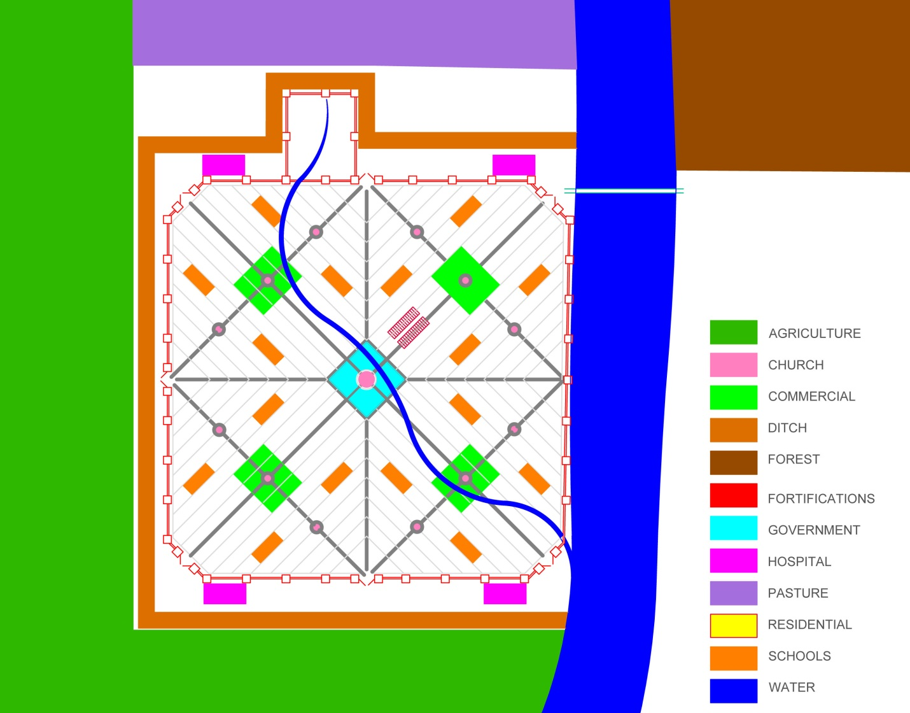
Overall City Plan
“Every city is divided into four equal districts”

Slide 3
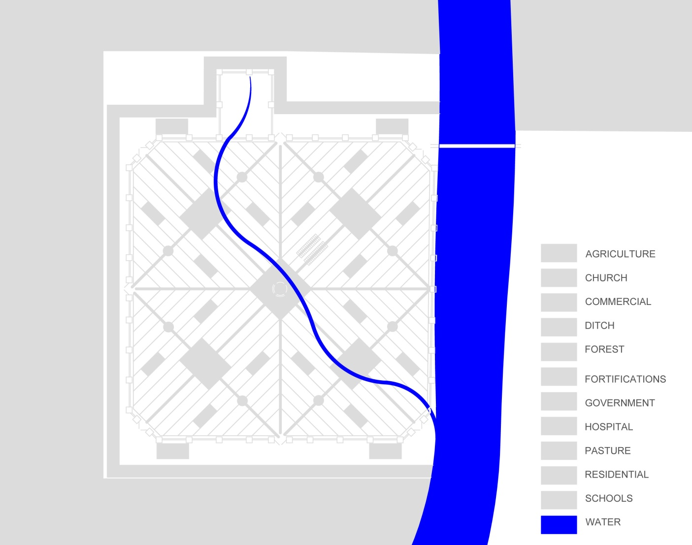
Rivers and Streams
“There is also another stream … which rises out of the hill, and flows down through the center of town and into the Anyder.”

Slide 4
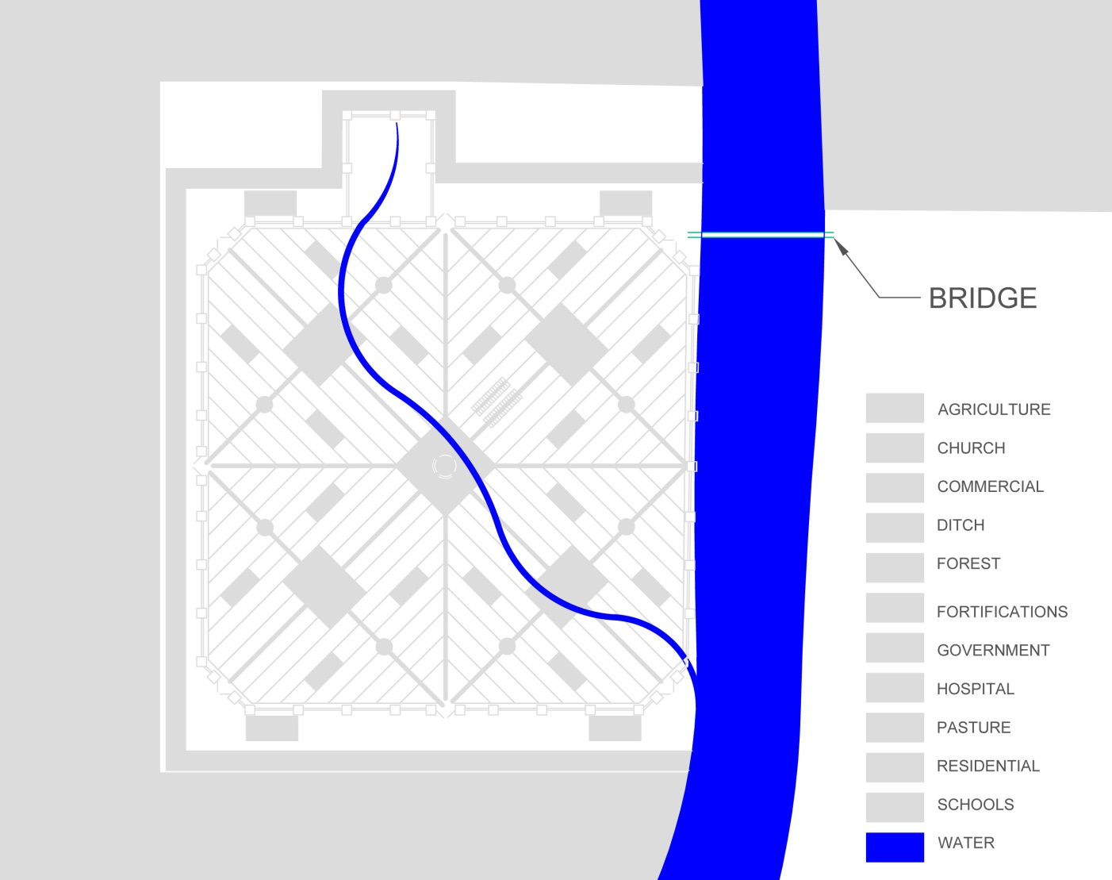
Bridge
“The two banks of the river at Amaurot are linked by a bridge, built ... on remarkable stone arches”

Slide 5
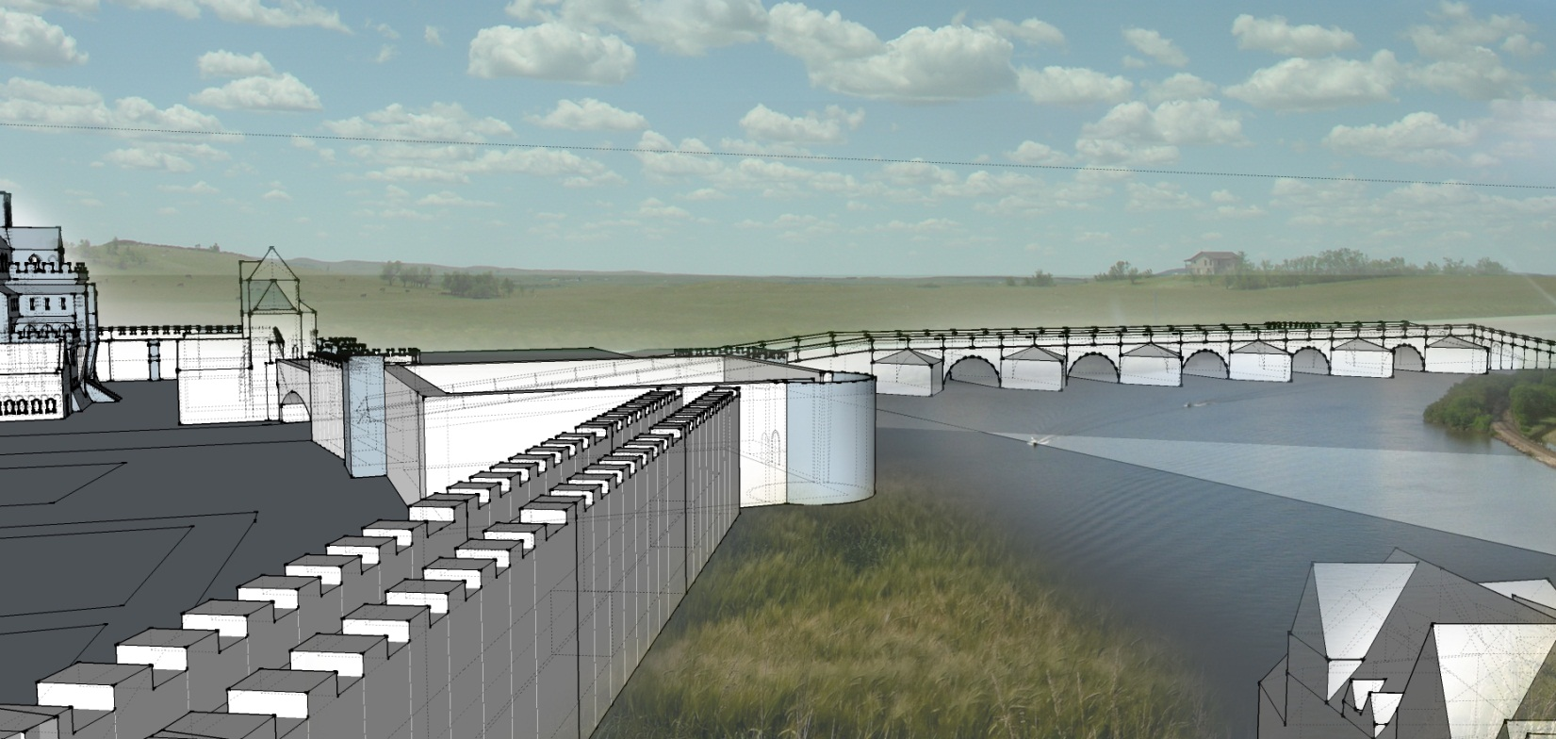
Bridge
“The two banks of the river at Amaurot are linked by a bridge, built ... on remarkable stone arches”

Slide 6
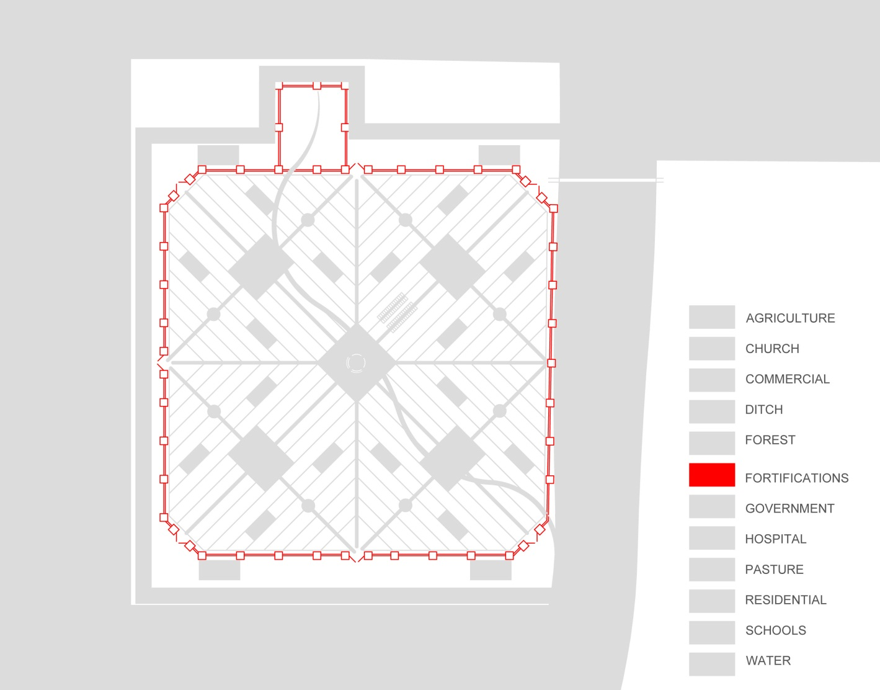
Fortifications
“The town is surrounded by a thick, high wall, with many towers and bastions.”

Slide 7
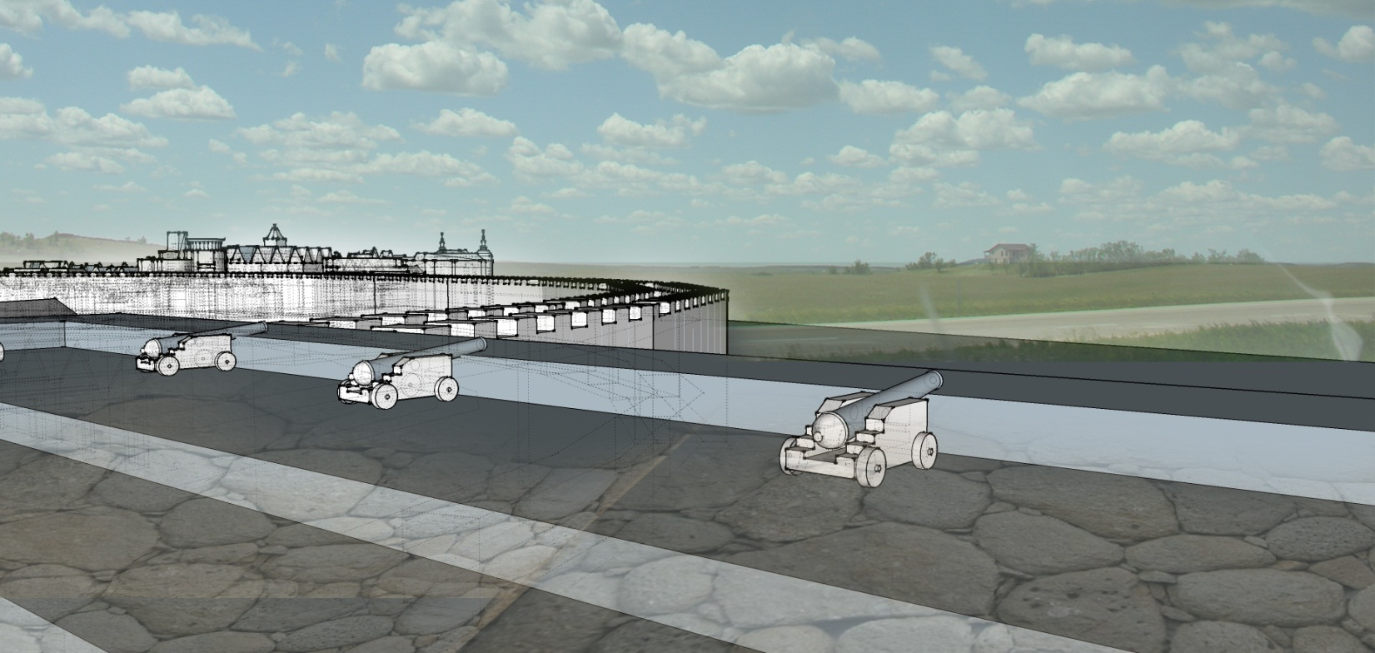
Fortifications
“The town is surrounded by a thick, high wall, with many towers and bastions.”

Slide 8
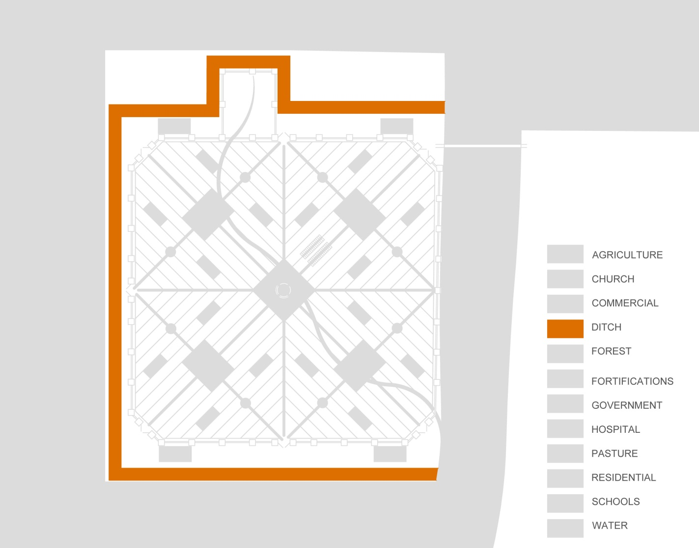
Ditch
“On three sides, it is also surrounded by a dry ditch, broad and deep and filled with thorn hedges”

Slide 9
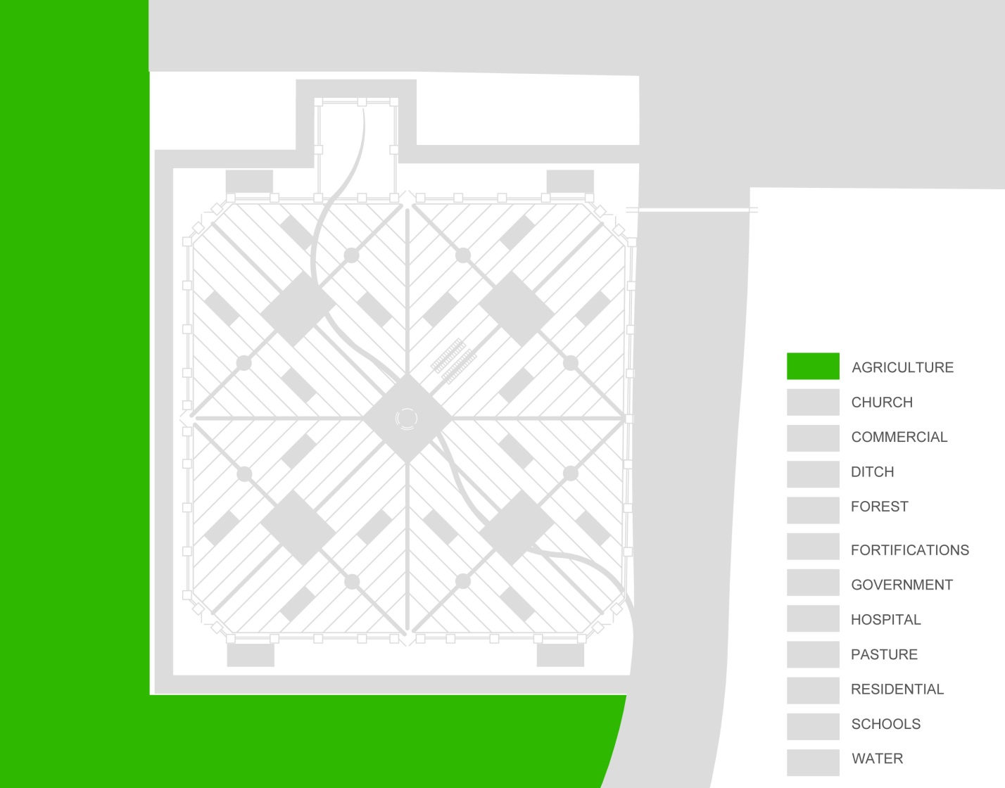
Agriculture
“Every city has enough ground assigned to it so that at least twelve miles of farm land are available in every direction”

Slide 10
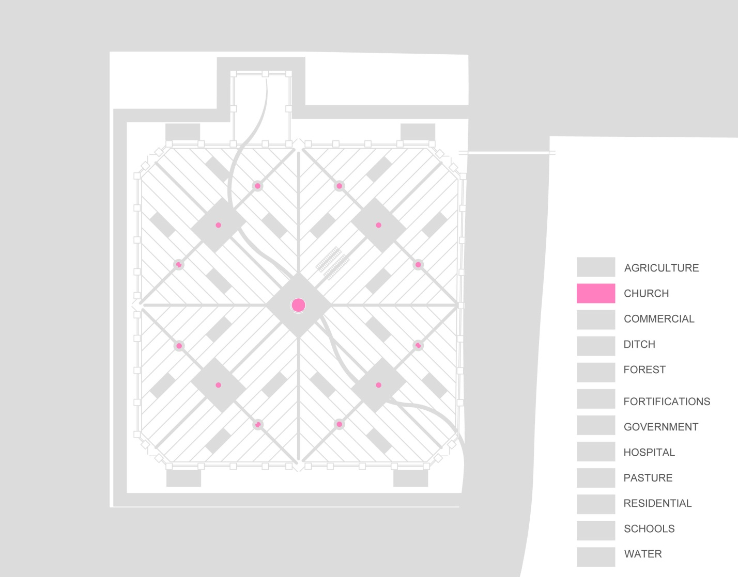
Churches
“In each city, there are no more than 13 [Priests], One for each church.”

Slide 11
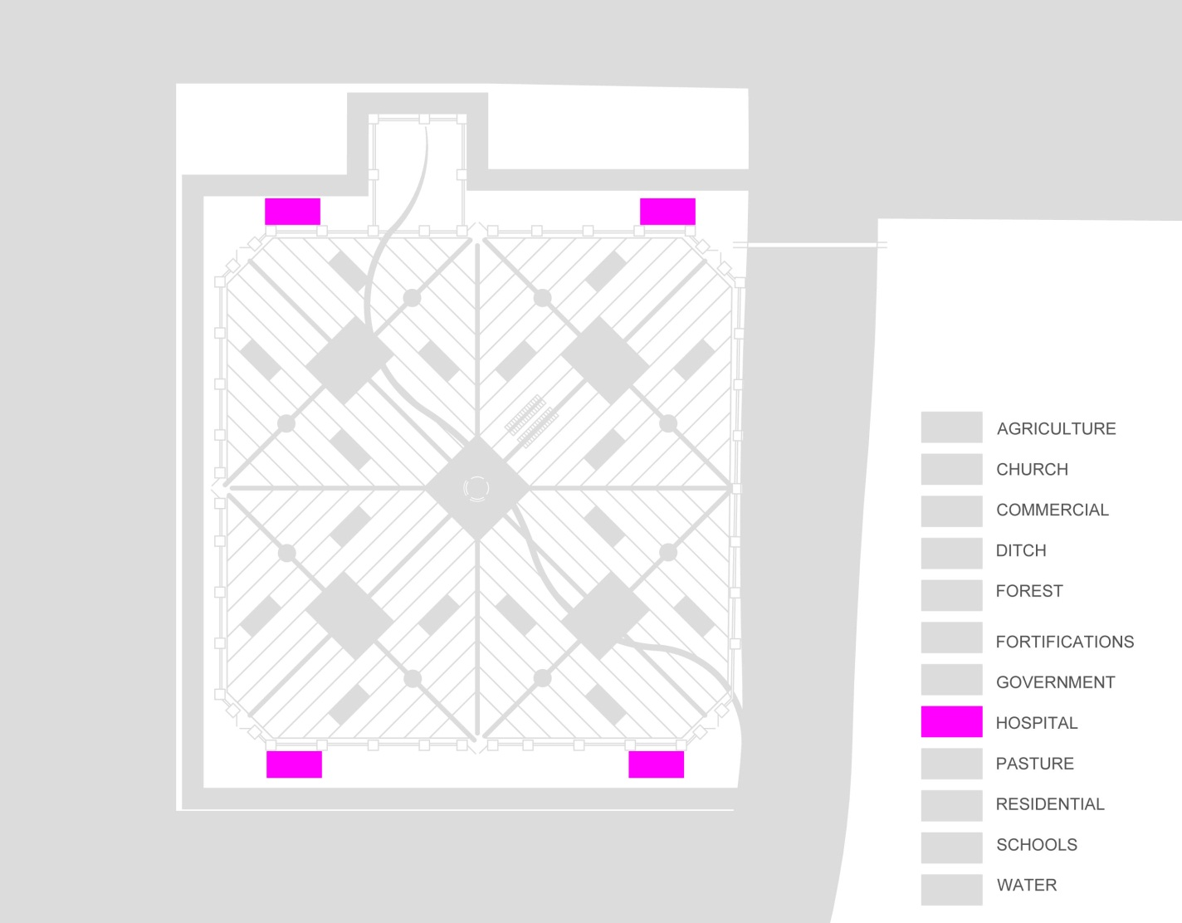
Hospitals
“Every city has four [hospitals], built at the city limits, slightly outside the walls, and spacious enough to appear like little towns”

Slide 12
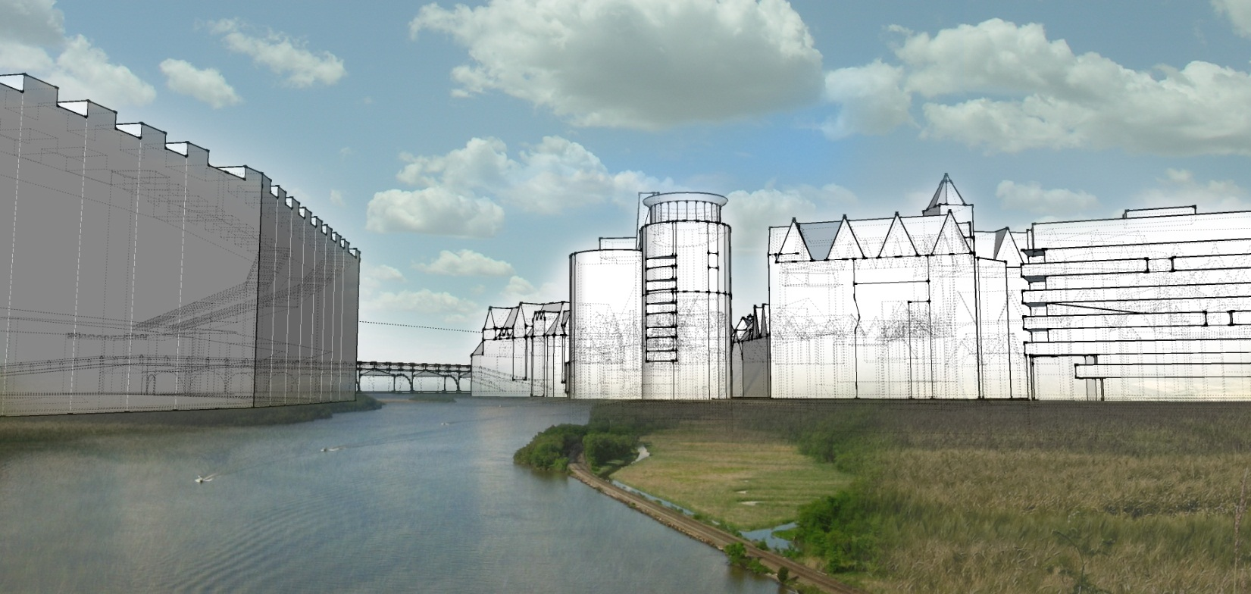
Hospital
“Every city has four [hospitals], built at the city limits, slightly outside the walls, and spacious enough to appear like little towns”

Slide 13
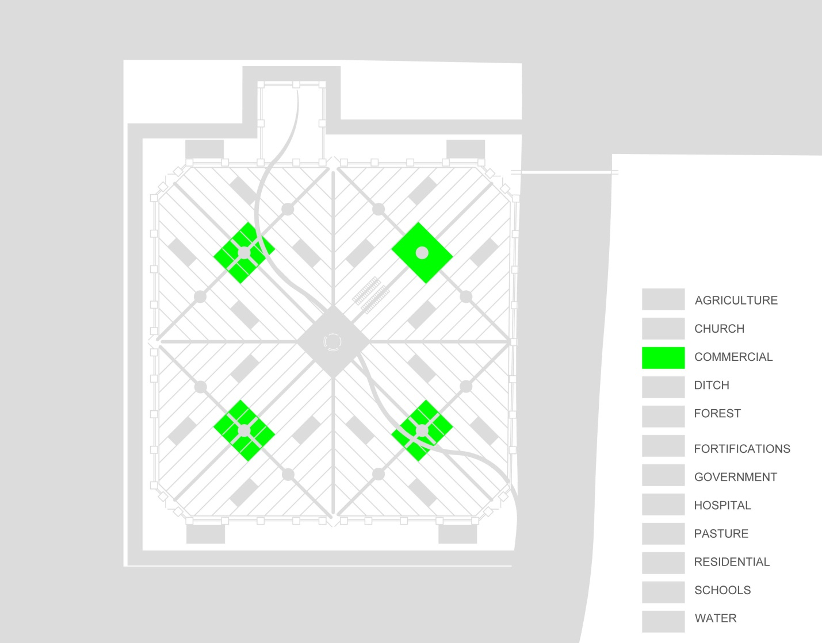
Markets
“and in the middle of each district is a market for all kinds of commodities.”

Slide 14
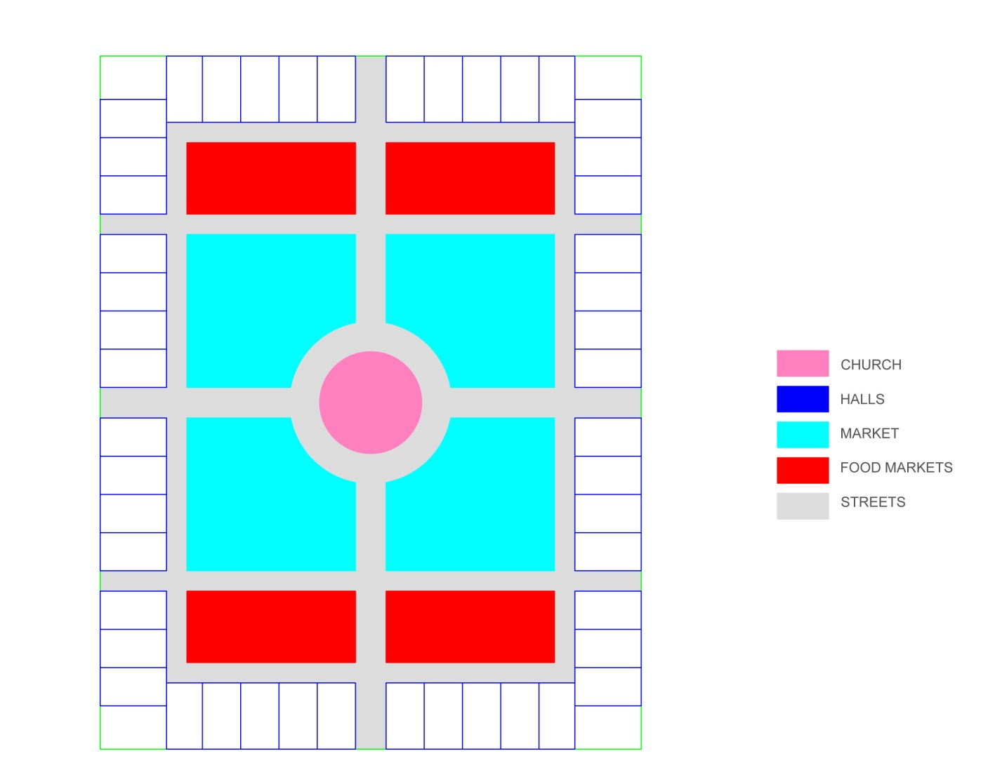
Market Plan
“Next to the marketplace … are the food markets, where people bring all sorts of vegetables, fruit, and bread.”

Slide 15
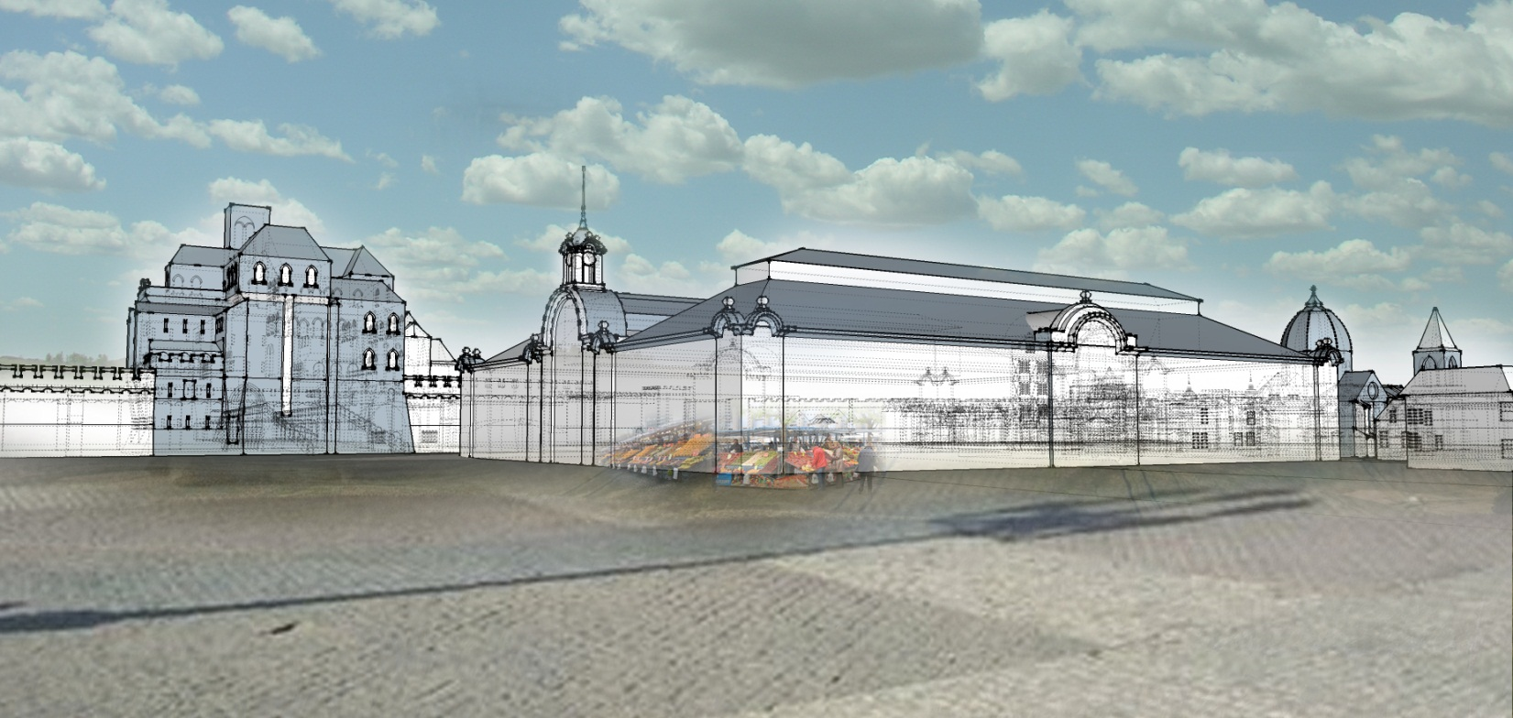
Market
“Next to the marketplace … are the food markets, where people bring all sorts of vegetables, fruit, and bread.”

Slide 16
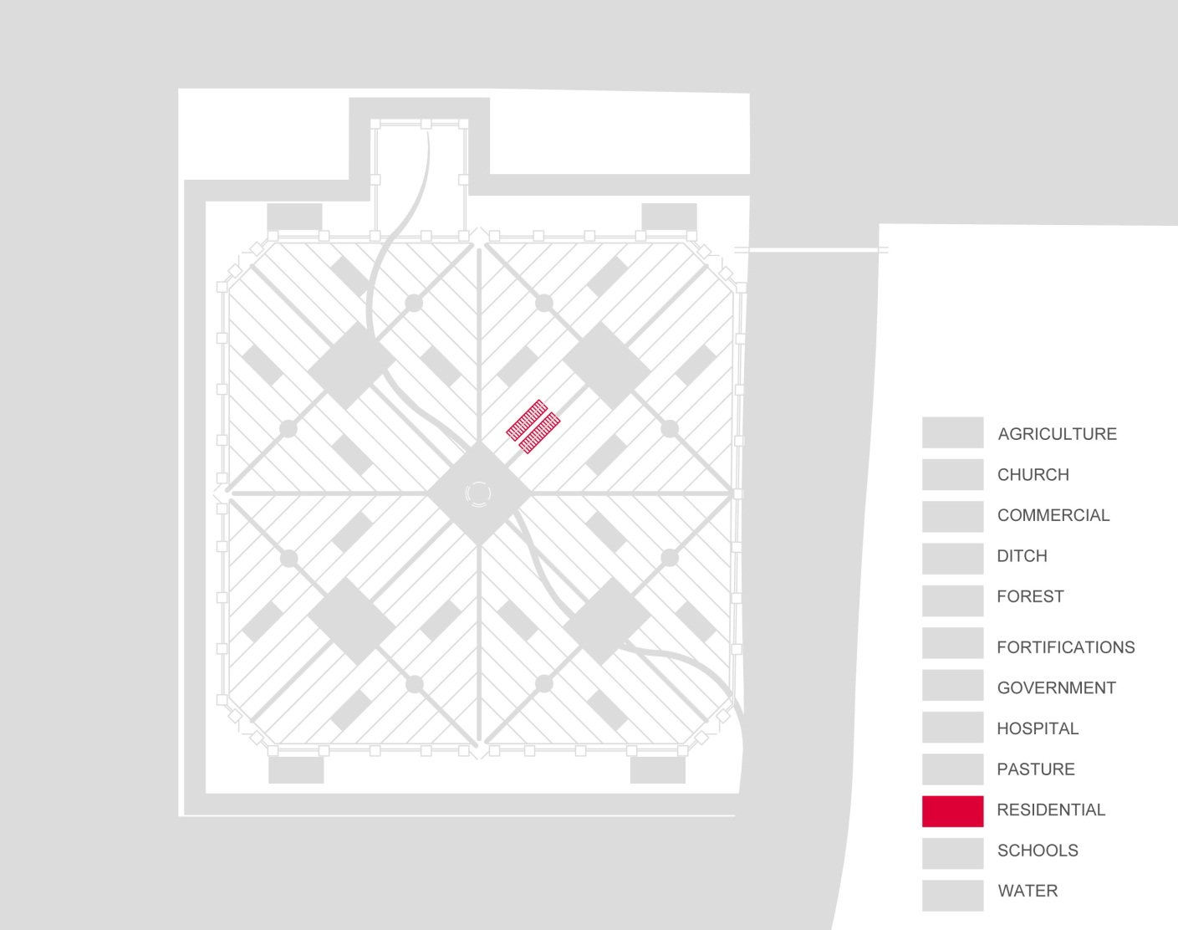
Residences
“Unbroken rows of houses facing each other across the streets through the different wards make a fine sight”

Slide 17
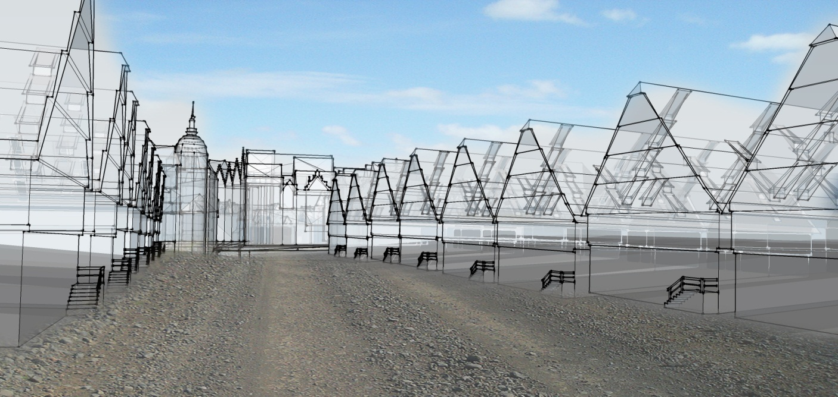
Residences
“Unbroken rows of houses facing each other across the streets through the different wards make a fine sight”

Slide 18
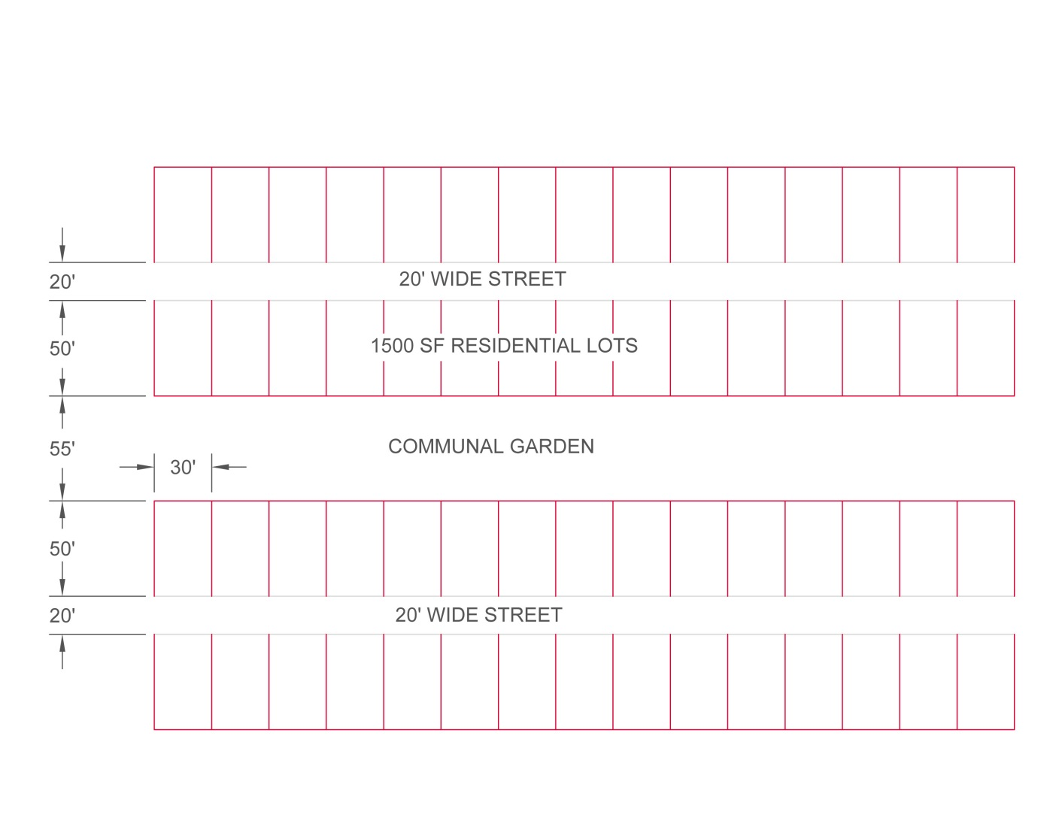
Gardens
“Behind each row of houses – at the center of every block and extending the full length of the street – there are large gardens”

Slide 19
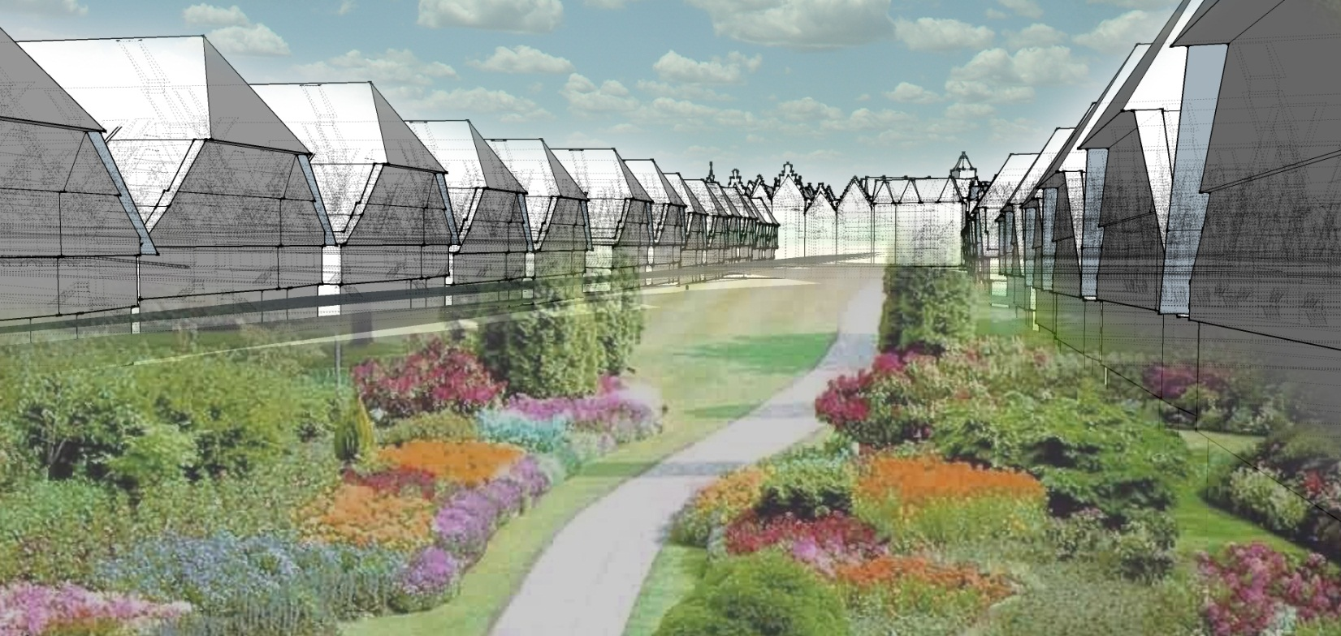
Gardens
“The Utopians are very fond of these gardens of theirs, they raise vines, fruits, herbs and flowers so well cared for and flourishing that I’ve never seen any gardens more productive or elegant than theirs”

Slide 20
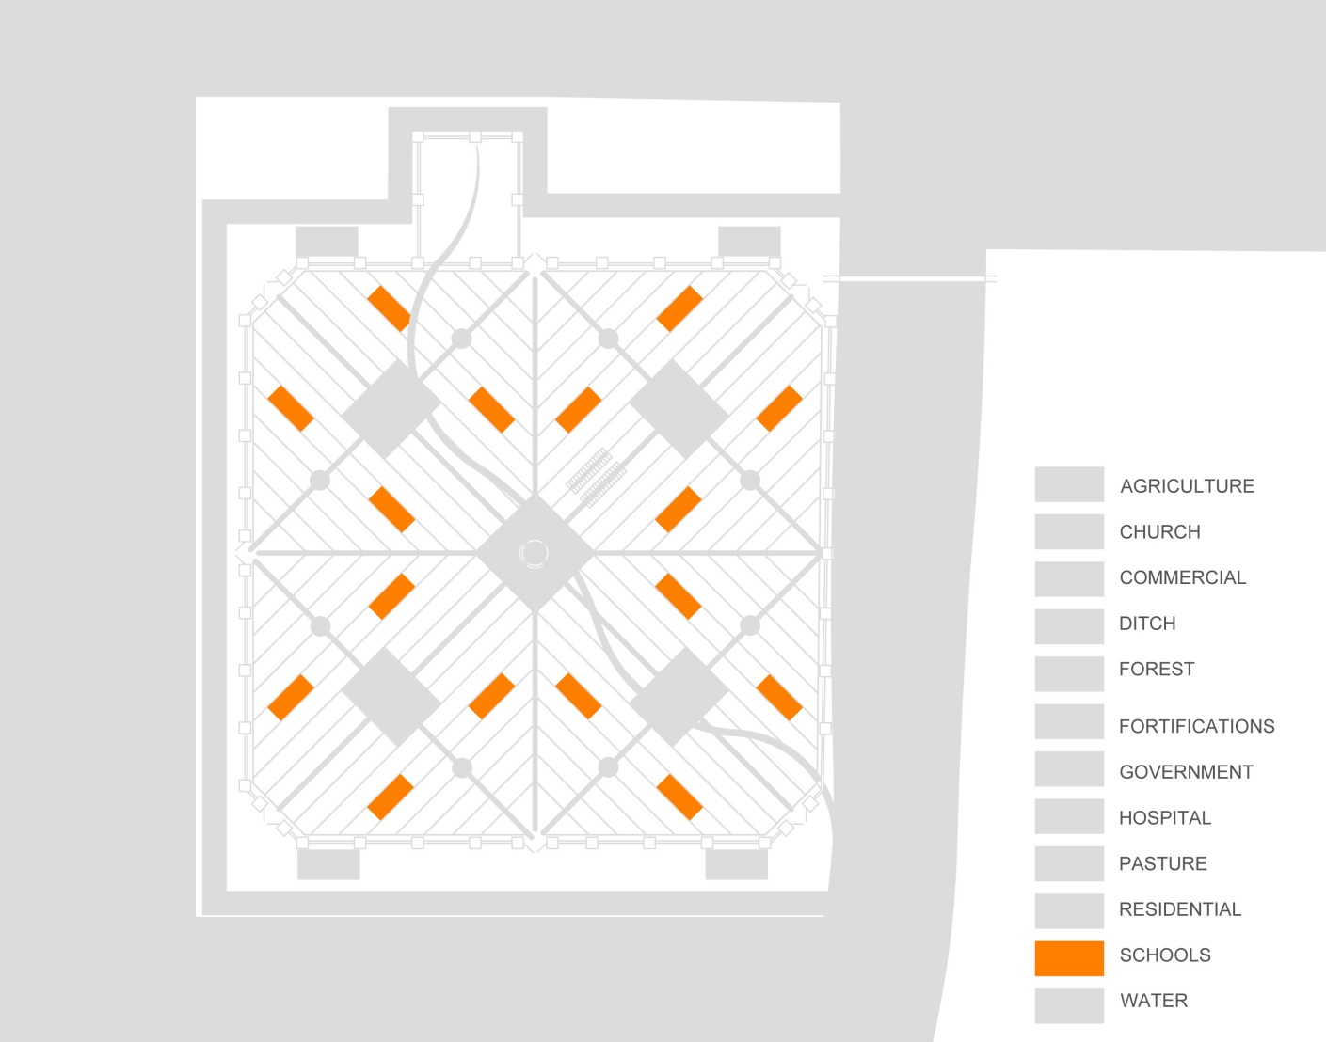
Schools
“They have an established custom of giving public lectures before daybreak”

Slide 21
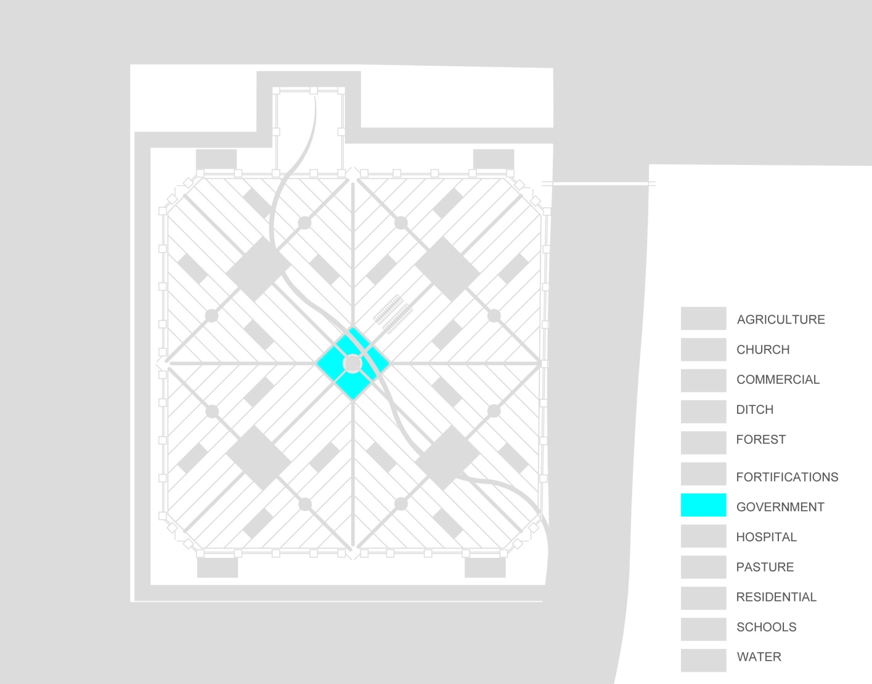
Government Buildings

Slide 22
Thank You!

